Slide 1
Chapter 10: Liabilities: Current, Installment Notes, and Contingencies
Financial& Managerial Accounting, 16e

Slide 2
Current Liabilities
When a company or a bank advances credit, it is making a loan.
The company or bank is called a creditor (or lender).
The individuals or companies receiving the loans are called debtors (or borrowers).
Debt is recorded as a liability by the debtor.
Long-term liabilities are debts due beyond one year.
Current liabilities are debts that will be paid out of current assets and are due within one year.

Slide 3
Accounts Payable and Accruals
Accounts payable transactions involve a variety of purchases on account, including the purchase of merchandise and supplies.
Accrued liabilities reflect an obligation to pay current assets in the future.
Accrued liabilities are normally recorded at the end of an accounting period as part of the adjustment process
For most companies, accounts payable and accrued liabilities are the largest portion of current liabilities.

Slide 4
Short-Term Notes Payable
Notes may be issued to purchase merchandise or other assets. Notes may also be issued to creditors to satisfy an account payable created earlier.

Slide 5
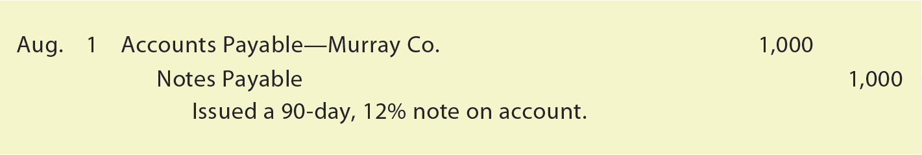
Short-Term Notes Payable
To illustrate, assume that Nature’s Sunshine Company issued a 90-day, 12% note for $1,000, dated August 1, to Murray Co. for a $1,000 overdue account. The entry to record the issuance of the note is as follows:

Slide 6
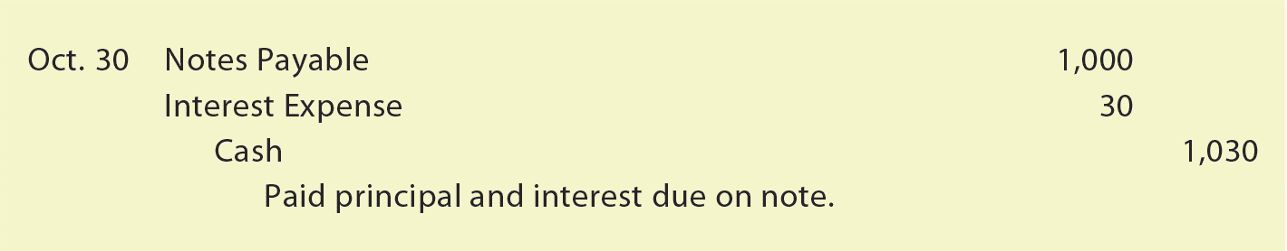
Short-Term Notes Payable (slide 3 of 10)
When the note matures, the entry to record the payment of $1,000 plus $30 interest ($1,000 × 12% × 90 ÷ 360) is as follows:
The interest expense is reported in the Other Expense section of the income statement.
The interest expense account is closed at December 31.

Slide 7
Short-Term Notes Payable
A company may also borrow from a bank by issuing a note.

Slide 8
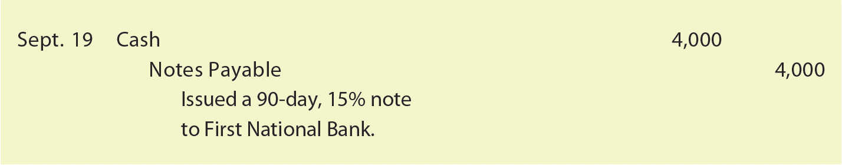
Short-Term Notes Payable
To illustrate, assume that on September 19, Iceburg Company borrowed cash from First National Bank by issuing a $4,000, 90-day, 15% note to the bank. The entry to record the issuance of the note and the cash proceeds is as follows:

Slide 9
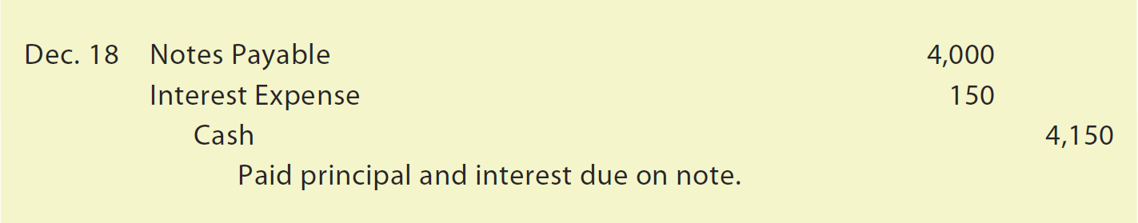
Short-Term Notes Payable
On the due date of the note (December 18), Iceburg Company owes First National Bank $4,000 plus interest of $150 ($4,000 × 15% × 90 ÷ 360). The entry to record the payment of the note is as follows:

Slide 10
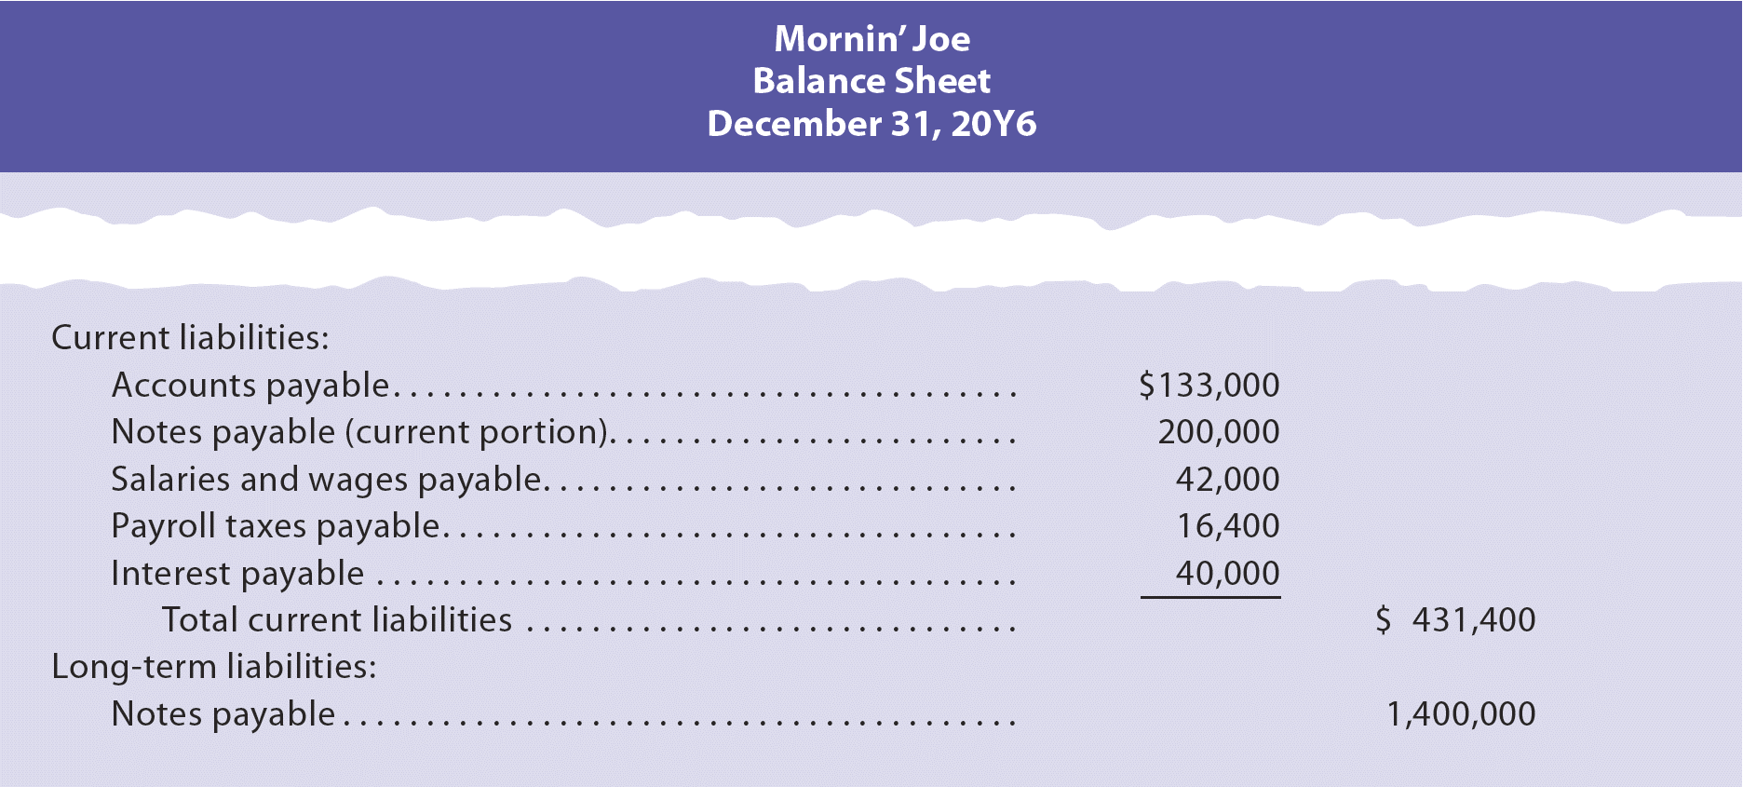
Reporting Liabilities

Slide 11
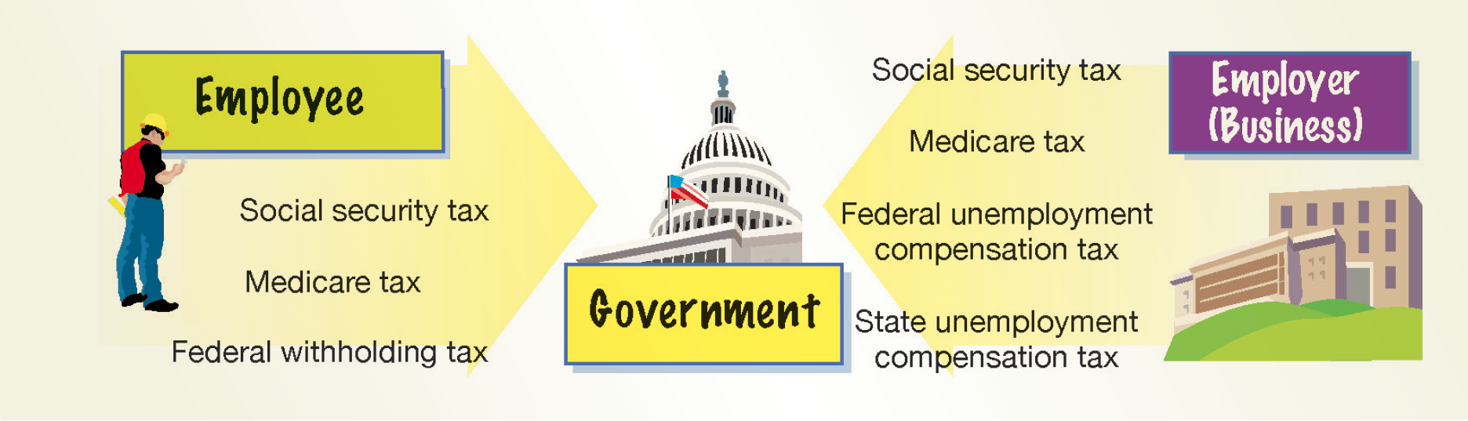
The Final Exam will not cover any material presented after this PowerPoint slide. Exhibit 3 – Responsibility for Tax Payments

Slide 12
Recording Payroll (1 of 5)
The payroll liabilities are normally recorded at the end of each payroll period.
The following data for McDermott Supply Co. for payroll period ending March 21 are used.
Payroll:
Sales salaries | $20,000
Office salaries | 5,000
Total payroll | $25,000
Salaries subject to payroll taxes:
Social security and Medicare | $25,000
State and federal unemployment tax | 10,000

Slide 13
Recording Payroll (2 of 5)
Payroll tax rates:
Social security tax | 6.0%
Medicare tax | 1.5
State unemployment compensation tax | 5.4
Federal unemployment compensation tax | 0.8
Employee deductions:
Federal income tax withholdings | $2,100
State income tax withholdings | 550
Retirement contributions | 1,200
Charitable contributions | 250

Slide 14
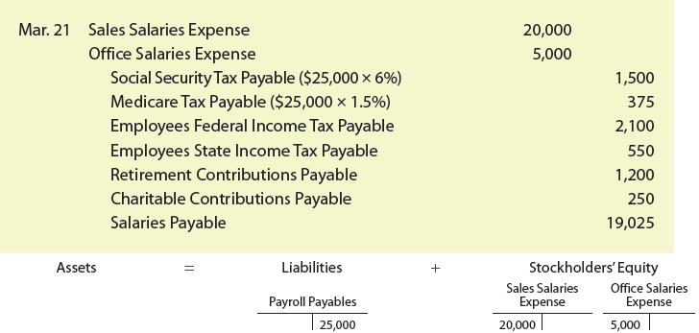
Recording Payroll (3 of 5)
The journal entry to record the March 21 payroll is as follows:

Slide 15
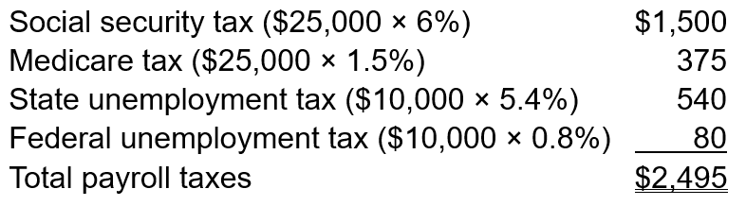
Recording Payroll (4 of 5)
Employers must match the employees’ social security and Medicare taxes.
In addition, an employer must pay state and federal unemployment compensation taxes.
The employer’s payroll taxes of $2,495 for the March 21 payroll are as follows:

Slide 16
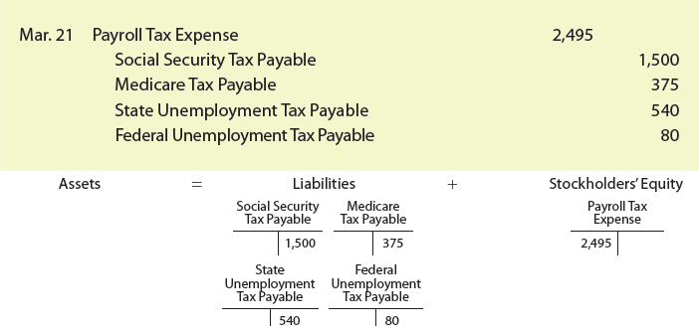
Recording Payroll (5 of 5)
The journal entry to record the payroll tax expense is as follows:

